Slide 1

Batch Encryption Using AES in CBC Mode
Samantha Berry

Slide 2
AES (Advanced Encryption Standard)
Established in 2001 by the U.S. National Institute of Standards and Technology (NIST).
It is a Block Cypher, meaning it takes in blocks of data of a fixed length as input
For my implementation, the length is 128-bit
Is a Symmetric Key algorithm, meaning it needs a key in order to encrypt and decrypt input
In order to decrypt something you need the same key as was used to encrypt it

Slide 3
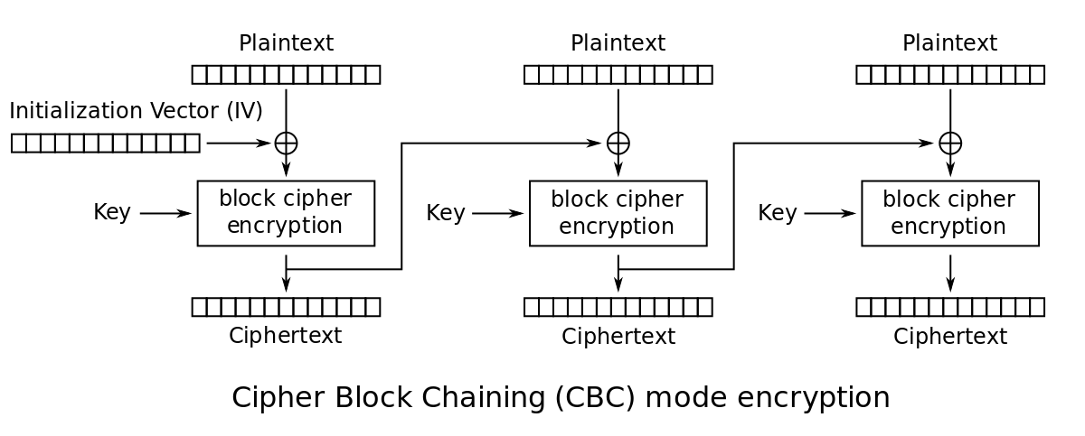
CBC Mode (Cipher Block Chaining)
The principles of CBC implementation into cyphers invented in 1976
Uses Block Chaining to increase security for inputs made up of multiple cypher blocks
CypherText of last block XORed with plaintext of current block
Image Source: https://en.wikipedia.org/wiki/Block_cipher_mode_of_operation#/media/File:CBC_encryption.svg

Slide 4
My Project
Implementation of AES with CBC mode for file encryption and decryption
Chose CBC Mode for added security for larger files
Focused on .txt files for ease of transforming data into 128-bit blocks
1 char = 8 bits, 16 char per block
Able to encrypt or decrypt multiple files in one session
Command Line Interface
Asks if preforming encryption or decryption
Asks for key
Enter in command line, read from file, or (Encryption Only) randomly generate
Preforms encryption or decryption

Slide 5
Testing
Individual program components tested using unit testing
Parts Tested Using Unit Testing:
AES Encryption
AES Decryption
Input String to 128-bit Hex Array / 128-bit Hex Array to Input String
Plaintext -> Hex Array -> Encryption -> Decryption -> Hex Array -> Plaintext
Manual checks for file read/write
Check program logs and file outputs to make sure expected output

